Slide 1
UI Development Advance
Introduction to HTML, CSS, JavaScript

Slide 2
HTML, CSS & JavaScript

Slide 3
How web Frontend and Backend work?

Slide 4
Frontend and Backend
Frontend is the user interface;
backend handles data and processes behind the scenes.
They communicate to make the website work smoothly.

Slide 5
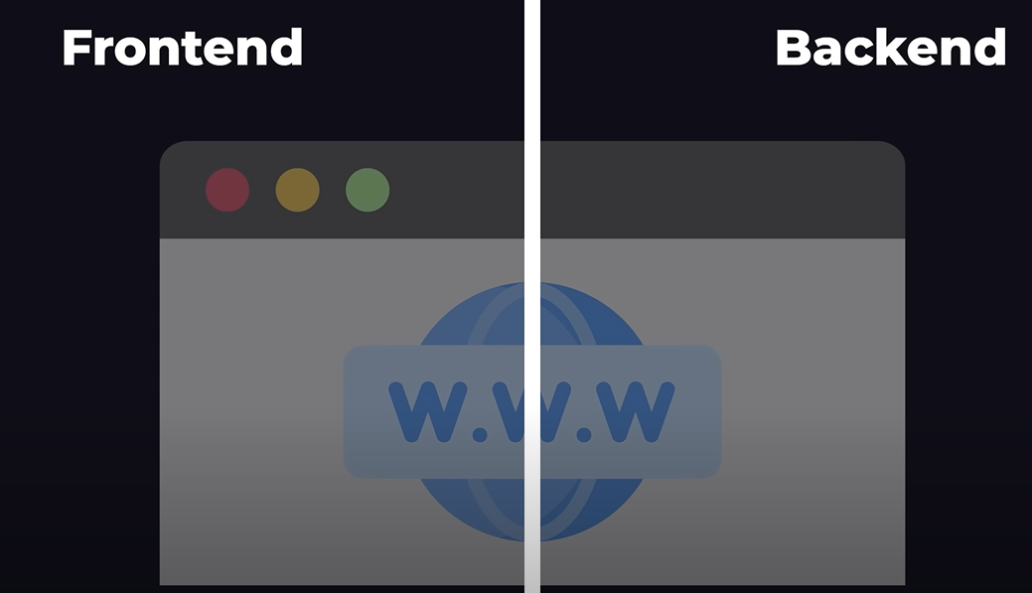
Note: Every Web Application can be divided into two parts

Slide 6
Frontend?

Slide 7
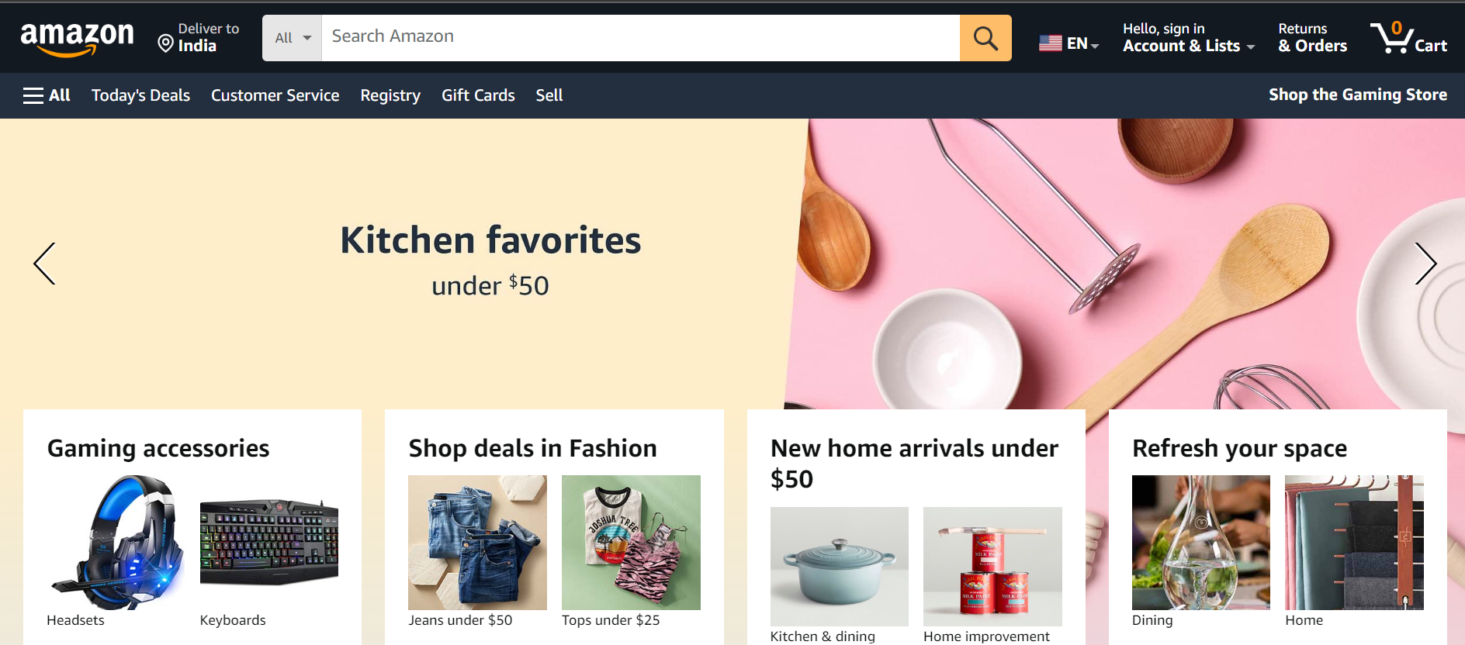
Note: Frontend means the Visual part of web application.

Slide 8
Backend?

Slide 9
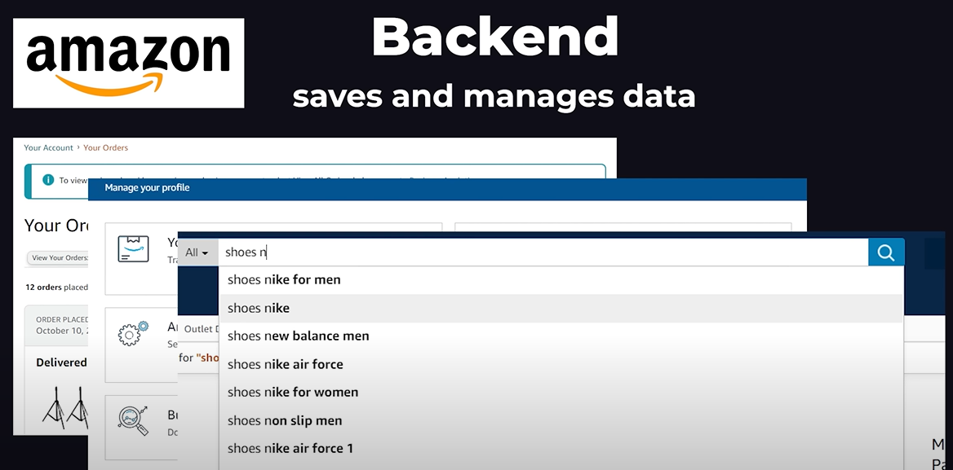
Note: Backend is all about how to manage/process or store the data coming from frontend into database,
Like user history user profile etc.

Slide 10
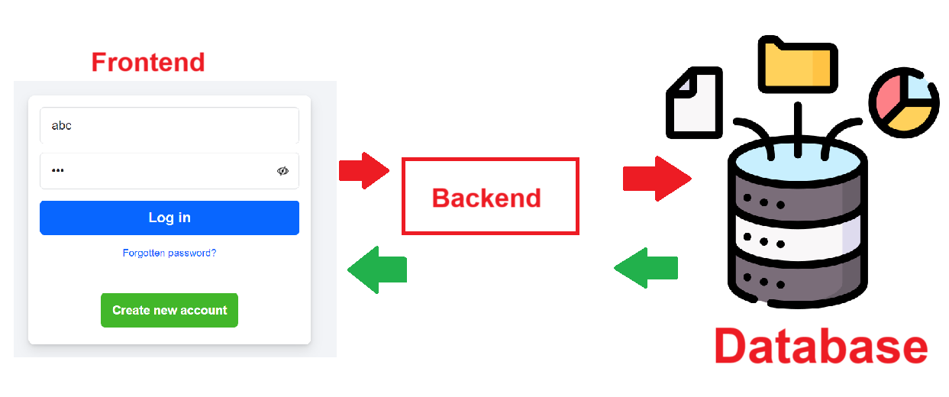

Slide 11
What are the different Web technologies?

Slide 12
What are the different Web technologies?
HTML: Structure of webpages.
CSS: Styling and layout.
JavaScript: Interactive features.
Frontend libraries: React.
Frontend frameworks: Angular, Vue.js.
Backend: Node.js, Django, Flask.
Databases: MySQL, MongoDB.
APIs: Connect frontend to backend.

Slide 13
Note
A library contains pre-written code that you use as needed.
A framework provides a fully structured, customizable way to create an application, guiding its development.

Slide 14
Types of Applications

Slide 15
Types of Applications
Standalone Applications/Desktop applications
Web applications
Mobile Applications

Slide 16
Standalone or Desktop application
An application executed individually or independently is called standalone or desktop application.
These applications installed in system and run from same system.
Example: Calculator, MS-Paint, MS-Word, MS-Excel.

Slide 17
Web Application
An application whose resources are accessed from browser are called web applications.
Example: gmail.com, facebook.com, & amazon.com etc.

Slide 18
Mobile Applications
An application which runs inside module and does not uses any other resources is called mobile applications.
Example: calculator, clock, contacts, calendar…

Slide 19
Software required for developing web application or web site

Slide 20
Download
VSCode is IDE (Visual Studio Code)
https://code.visualstudio.com/download

Slide 21
Install
Extensions
VScode icons
IntelliSense CSS
LiveServer

Slide 22
Physical path
& Virtual path

Slide 23
Physical path
A local directory or location where all application resources are stored or saved.
Example: d:\flipkart

Slide 24
Virtual path
Always a website or web application is accessed using virtual path.
This virtual path is called URL Uniform resource locator.
This virtual path is created when web application/website go into live.
Note: on local machine, virtual path is created by local server.

Slide 25
What is browser?

Slide 26
Browser
Browser is a software used to communicate with web application.
Brower is able to open any content (html, images, audio, video,..)
Example: Google Chrome, Edge, Mozilla Firefox

Slide 27
HTML
Hypertext Markup Language

Slide 28
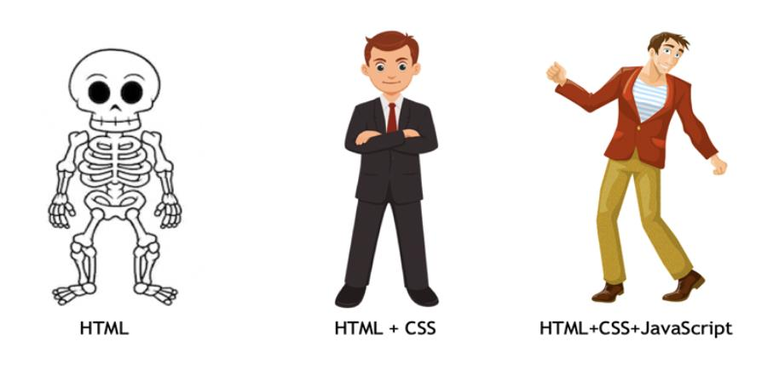

Slide 29
HTML: Structure of webpages.
CSS: Layout of webpages.
JS: Function of webpages.

Slide 30
HTML
Hypertext Markup Language
Programming Language
write the program
Compile
Run , see the output
Markup Language
write the program.
run , see the output

Slide 31
What is HTML?

Slide 32
HTML (Hypertext Markup Language) is a standard language used to create web pages. It is the backbone of a website, providing the structure and content that the web browser renders to the user.

Slide 33
What is CSS?

Slide 34
CSS (Cascading Style Sheets) is a styling language used to control the layout and appearance of web pages.

Slide 35
What is JavaScript?

Slide 36
JavaScript is used to add interactivity and functionality to a webpage, making it more engaging and user-friendly.

Slide 37
Who created HTML?

Slide 38
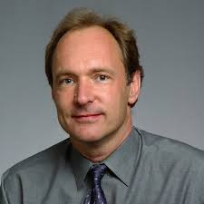
HTML was created by Tim Berners-Lee in 1991. He is also responsible for several other key technologies

Slide 39
Other key technologies

Slide 40
HTTP
HTML
URL
First Web Browser
Web Server
WWW

Slide 41
HTTP (HyperText Transfer Protocol):
Tim Berners-Lee also developed HTTP, a protocol for transferring hypertext requests and information on the internet.

Slide 42
HTML (HyperText Markup Language):
He created HTML to structure and present content on the web. HTML allows for the embedding of images, text, and links to other documents.

Slide 43
URL (Uniform Resource Locator):
Tim Berners-Lee developed the concept of URLs, which are addresses used to access resources on the internet.

Slide 44
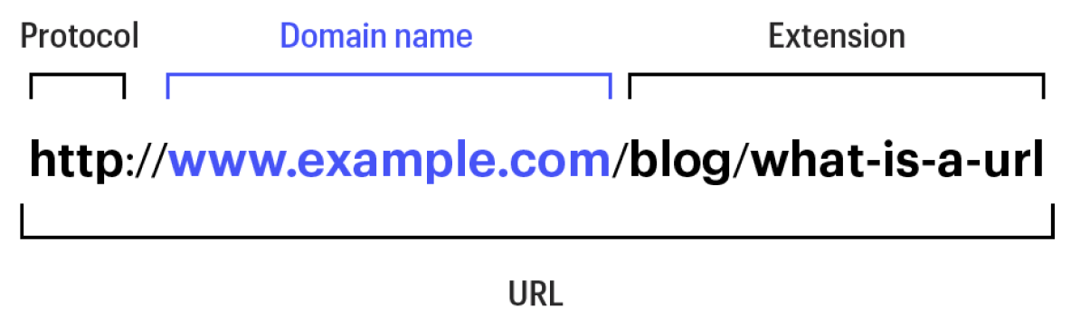

Slide 45
What is Web?

Slide 46
The Web is a network of:
Web pages (written in HTML, CSS, and JavaScript).
Web servers (that host and serve web pages).
Web browsers (that access and display web pages).
Hyperlinks (that connect web pages together).

Slide 47
Basic Structure of HTML

Slide 48
<tagname> ---- open tag
</tagname> --- closing tag

Slide 49
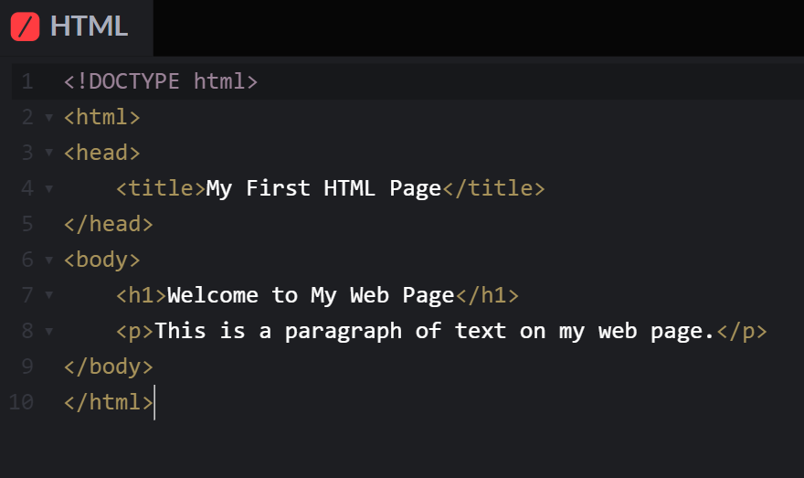

Slide 50
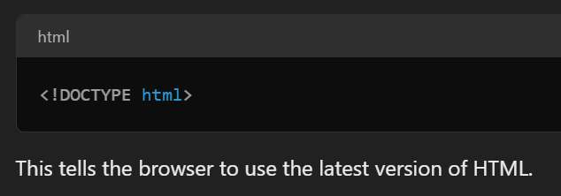

Slide 51
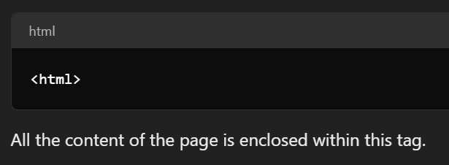

Slide 52
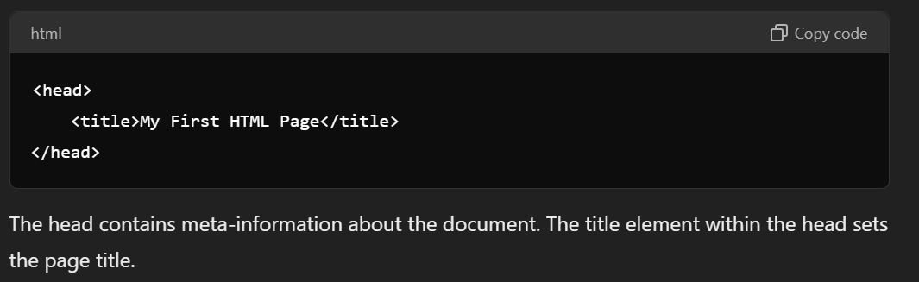

Slide 53
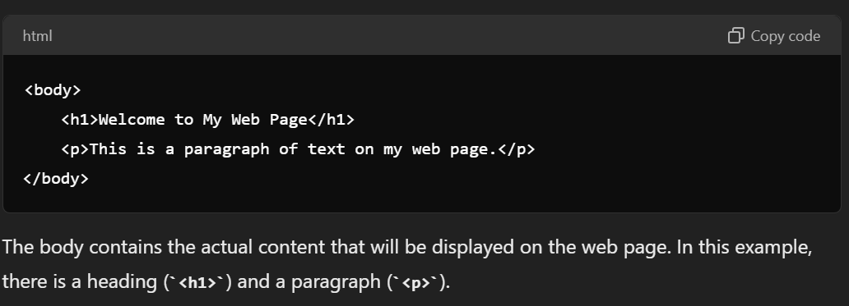

Slide 54
Tags and Attribute

Slide 55
HTML Tags:
Building blocks of HTML, used to define elements in a web page.
Example: <p> for paragraphs.

Slide 56
Common HTML Tags:
Headings: <h1> to <h6> tags for different levels of headings.
Paragraphs: <p> tag for paragraphs.
Links: <a> tag for hyperlinks.
Images: <img> tag for images.
Lists: <ol> for ordered lists, <ul> for unordered lists.
Tables: <table> for tables.

Slide 57
HTML Attributes:
Attributes: Provide additional information about elements, included in the opening tag.

Slide 58
Common Attributes:
id: Unique identifier for an element.
class: One or more class names for an element.
src: URL of an image.
href: URL of a link.
alt: Alternative text for an image.
title: Extra information (tooltip) for an element.

Slide 59
Examples:
id and class:
<p id="intro" class="highlight">Text</p>
Image:
<img src="image.jpg" alt="Description">
Link:
<a href="https://example.com" title="Example">Link</a>

Slide 60
The HTML <pre> Element

Slide 61
<pre> element
The HTML <pre> element defines preformatted text.
The text inside a <pre> element is displayed in a fixed-width font (usually Courier), and it preserves both spaces and line breaks:

Slide 62
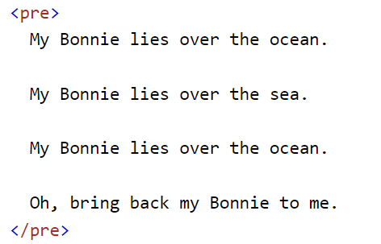
Example:

Slide 63
HTML Formatting Elements

Slide 64
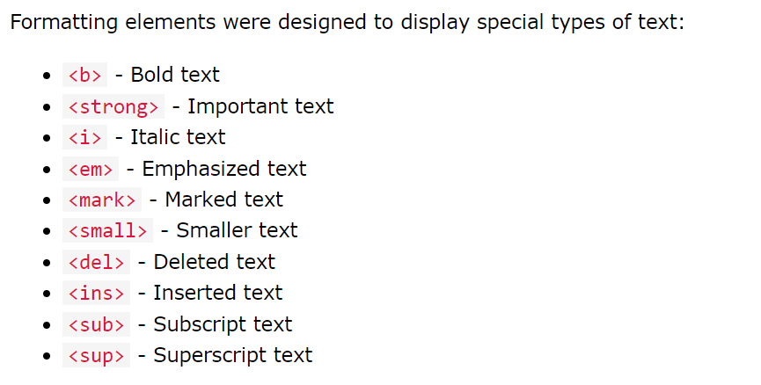
HTML Formatting Elements

Slide 65
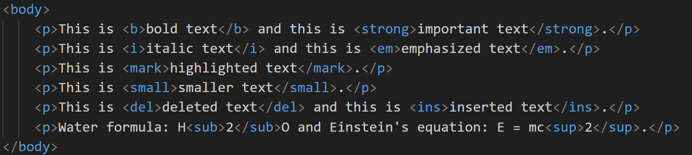
HTML Formatting Elements

Slide 66
HTML Block and Inline Elements

Slide 67
Key Differences:
Block-Level: Starts on a new line and takes up full width.
Inline: Stays in the same line, taking up only as much space as needed.

Slide 68
Block-level Elements
Definition: Block-level elements take up the full width available and always start on a new line.
Example: <div>, <p>, <h1> - <h6>, <ul>, <li>, <section>, <article>, <header>, etc.

Slide 69
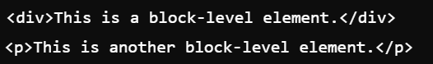
Block-level Elements

Slide 70
Inline Elements:
Definition:
Inline elements only take up as much width as necessary and stay on the same line as other content.
Example: <span>, <a>, <img>, <strong>, <em>, etc.

Slide 71
Inline Elements:

Slide 72
HTML Iframes

Slide 73
HTML Iframes
An HTML iframe is used to display a web page within a web page.

Slide 74
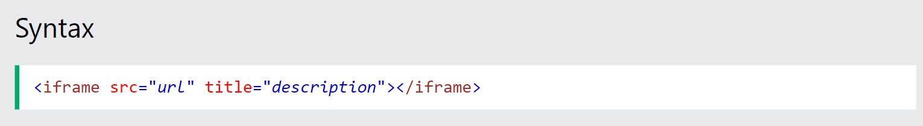
Syntax

Slide 75
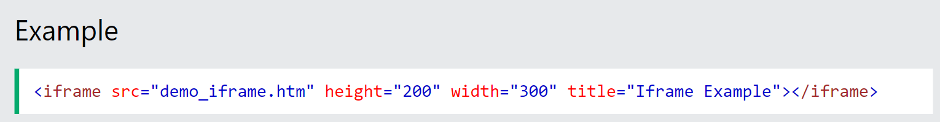
Example

Slide 76
HTML vs HTML5

Slide 77
HTML vs HTML5
HTML is the basic language for web pages, while HTML5 adds new features for multimedia and improved web functionality.

Slide 78
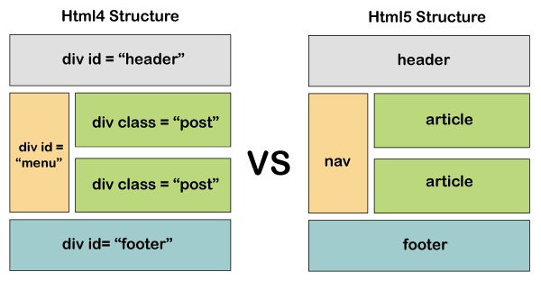
HTML vs HTML5

Slide 79
Semantic Elements

Slide 80
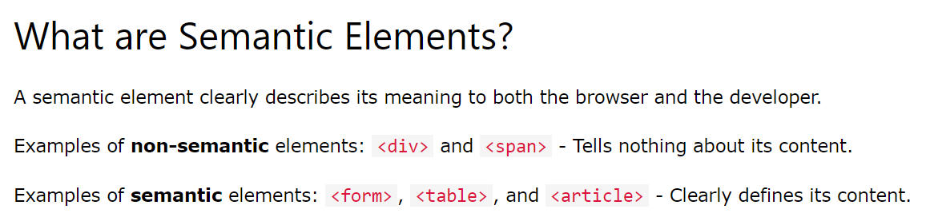
Semantic Elements

Slide 81
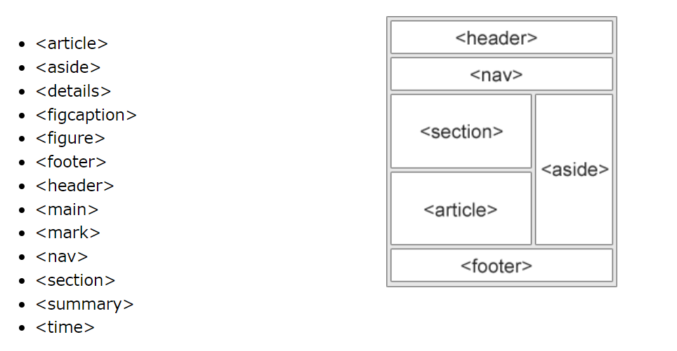
Semantic Elements

Slide 82
Types of CSS

Slide 83
Inline CSS
Internal CSS
External CSS

Slide 84
Inline CSS:
Inline CSS are directly applied on the HTML elements and it is the most prioritize CSS among these three. This will override any external or internal CSS.

Slide 85
Internal CSS:
Internal CSS are defined in the HTML head section inside of <style> tag to let the browser know where to look for the CSS.

Slide 86
External CSS:
External CSS are defined in a separate file that contains only CSS properties, this is the recommended way to use CSS when you are working on projects. you can use them by importing it into your HTML document using HTML <link> tag.

Slide 87
What is layout?

Slide 88
What is layout?
Layout is organizing of elements or content within web page is called layout.
Block
Inline
Inline block
Grid
Flex

Slide 89
inline
for elements having inline display, you cannot define
height or width.
It automatically adjust its height and width acc. to
content.

Slide 90
block
For elements having block display, you can define height
and width.
Block element always starts on a new line.
By default it occupies full line space.
It does not let anyone else come after it in the same line.

Slide 91
inline-block
Like inline element it does not start on a new line.
Like block level element, height and width can be defined.

Slide 92
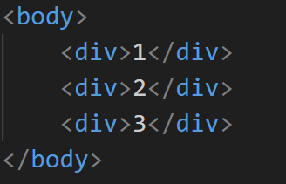
HTML

Slide 93
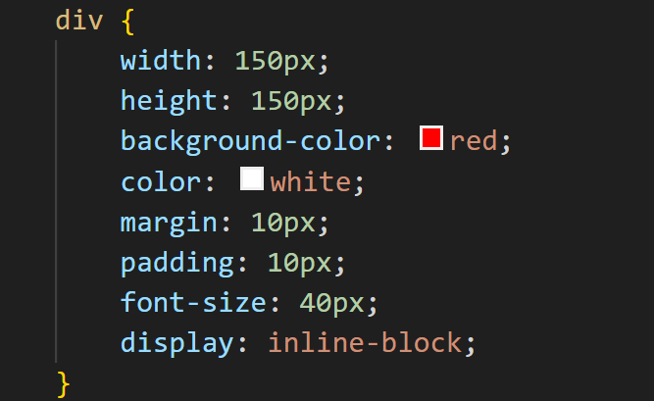
CSS

Slide 94
Flexbox Layout

Slide 95
What is Flexbox?
Flexbox (Flexible Box Layout) is a powerful CSS tool.
Flexbox makes it easy to build complex, responsive layouts and align items perfectly within a container.

Slide 96
Container Properties

Slide 97
display
display: flex

Slide 98
flex-direction
flex-direction: row | row-reverse | column | column-reverse

Slide 99
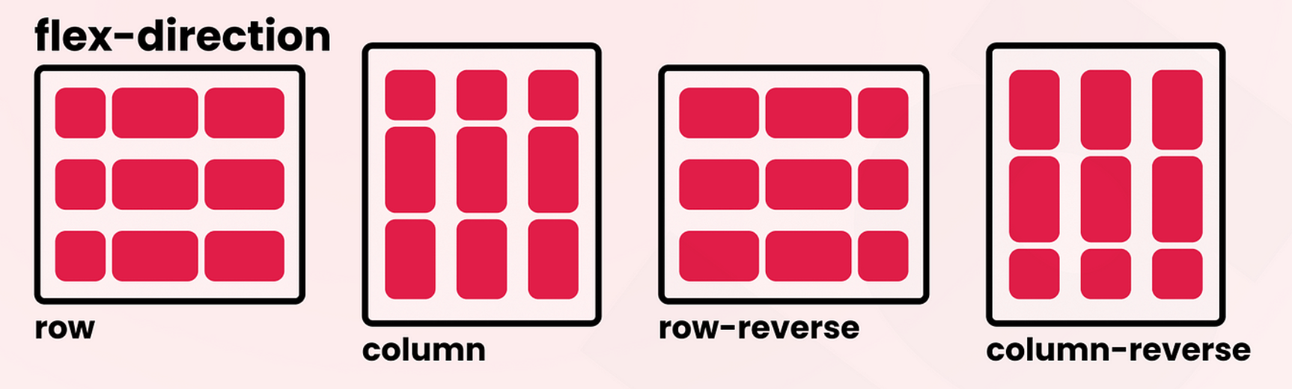
flex-direction

Slide 100
flex-wrap
flex-wrap: nowrap | wrap | wrap-reverse

Slide 101
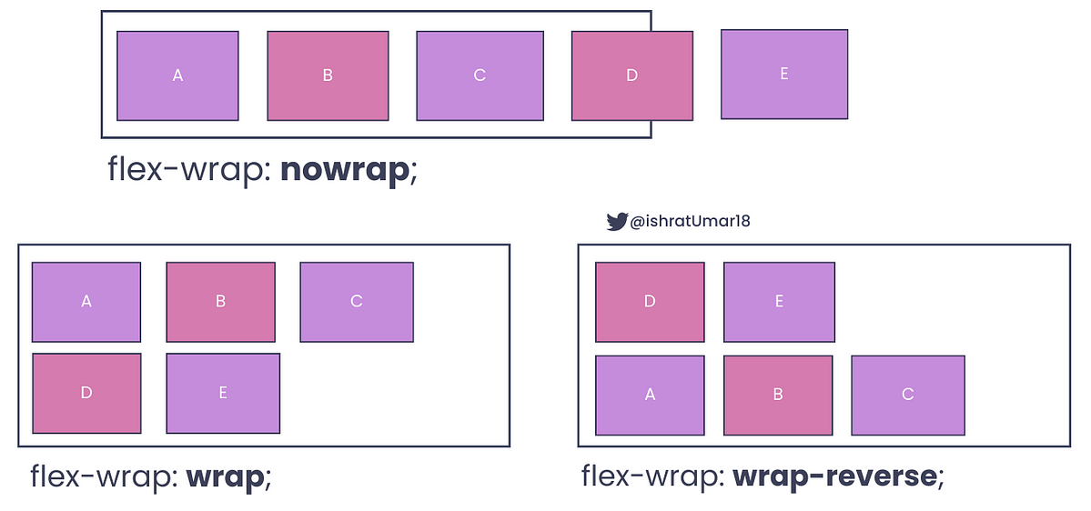
flex-wrap

Slide 102
justify-content
justify-content: flex-start | flex-end | center | space-between | space-around | space-evenly

Slide 103
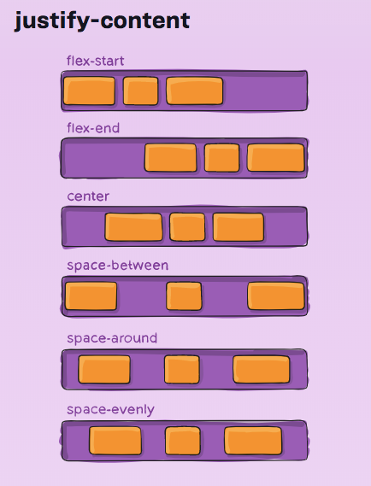

Slide 104
align-items
align-items: flex-start | flex-end | center | stretch | baseline

Slide 105

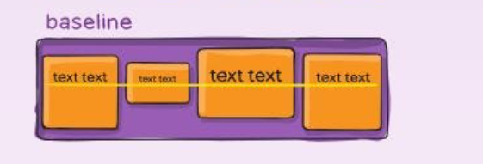
align-items

Slide 106
Item Properties

Slide 107
order
order: <integer>
e.g. order: 1

Slide 108
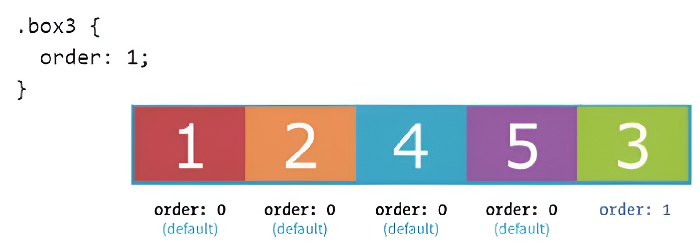
order

Slide 109
flex-grow
flex-grow: <number>
e.g. flex-grow: 2

Slide 110
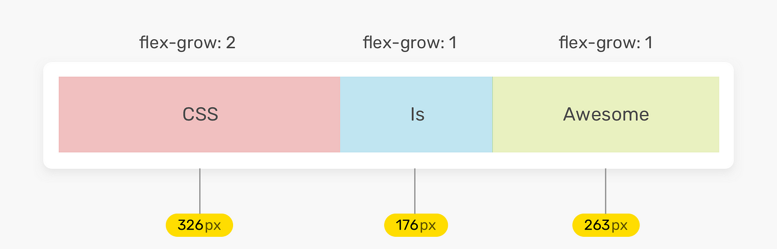
flex-grow

Slide 111
flex-shrink
flex-shrink: <number>
e.g. flex-shrink: 1

Slide 112
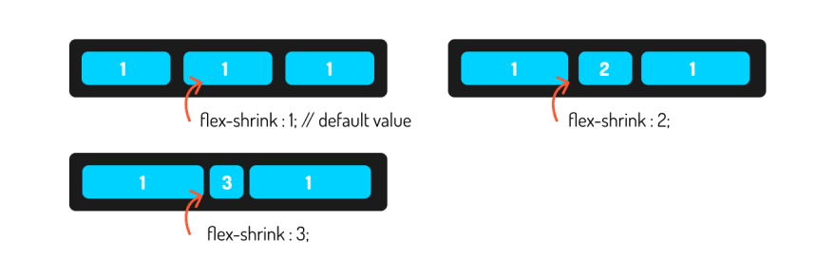
flex-shrink

Slide 113
Learn Display Flex by Game
Visit: https://flexboxfroggy.com/

Slide 114
Grid Layout

Slide 115
What is CSS Grid?
CSS Grid is a system that helps you arrange items on a webpage in rows and columns, like a spreadsheet.
It makes it easy to design complex layouts by giving you control over the placement and size of elements.

Slide 116
Grid vs Flexbox

Slide 117
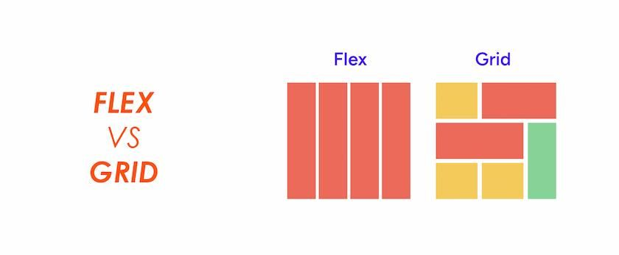
Flexbox vs Grid

Slide 118
Flexbox vs Grid
Flexbox is great for laying out items in a single row or column. Think of it as a container that stretches to fit its contents.
Grid is for creating complex layouts with rows and columns. It's like a spreadsheet for your website!

Slide 119
Parent Grid Properties

Slide 120
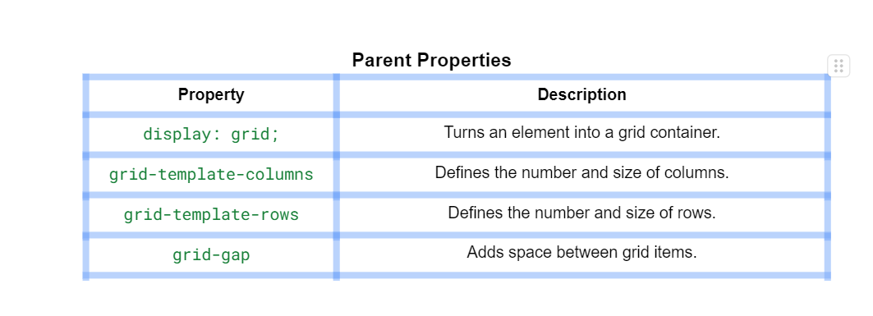
Parent Grid Properties

Slide 121
Children Grid Properties

Slide 122
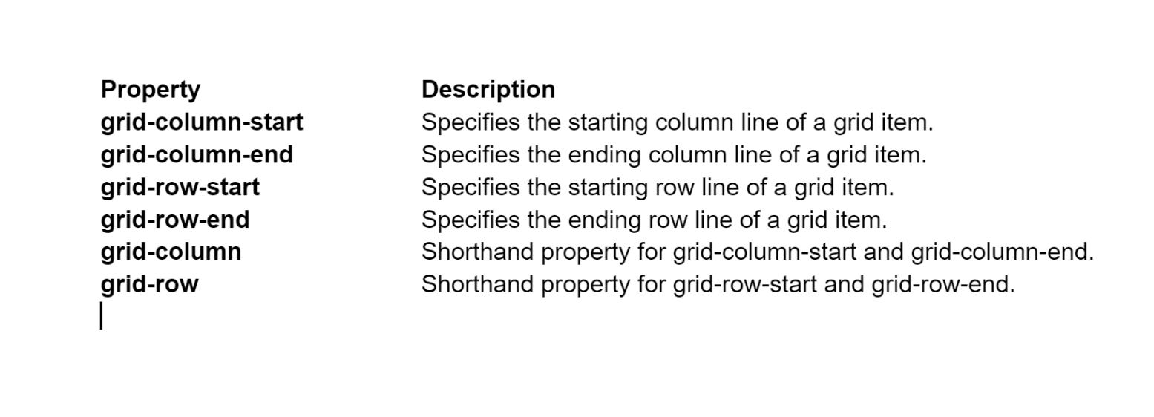
Children Grid Properties

Slide 123
display: grid;
Defines the container as a grid container.

Slide 124
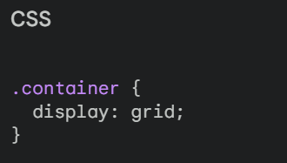
display: grid;

Slide 125
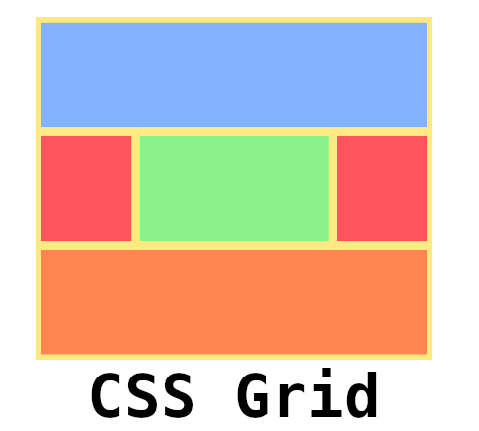
display: grid;

Slide 126
grid-template-rows
Defines the size of rows
(repeat(4, 1fr)).

Slide 127
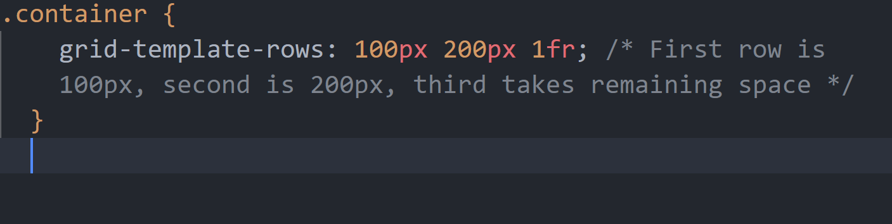
grid-template-rows

Slide 128
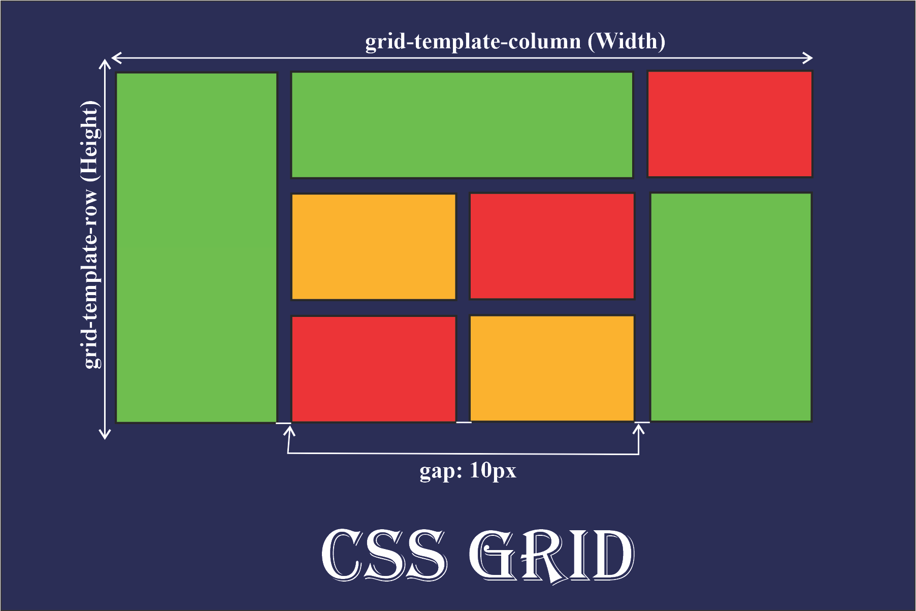
grid-template-rows

Slide 129
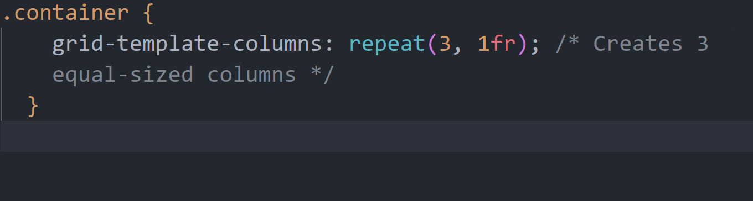
grid-template-columns
Defines the size of columns (repeat(3, 1fr)).

Slide 130
grid-template-columns

Slide 131
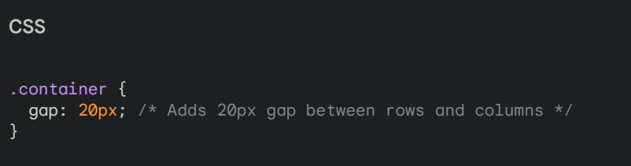
gap
Sets the gap between grid items (10px).

Slide 132
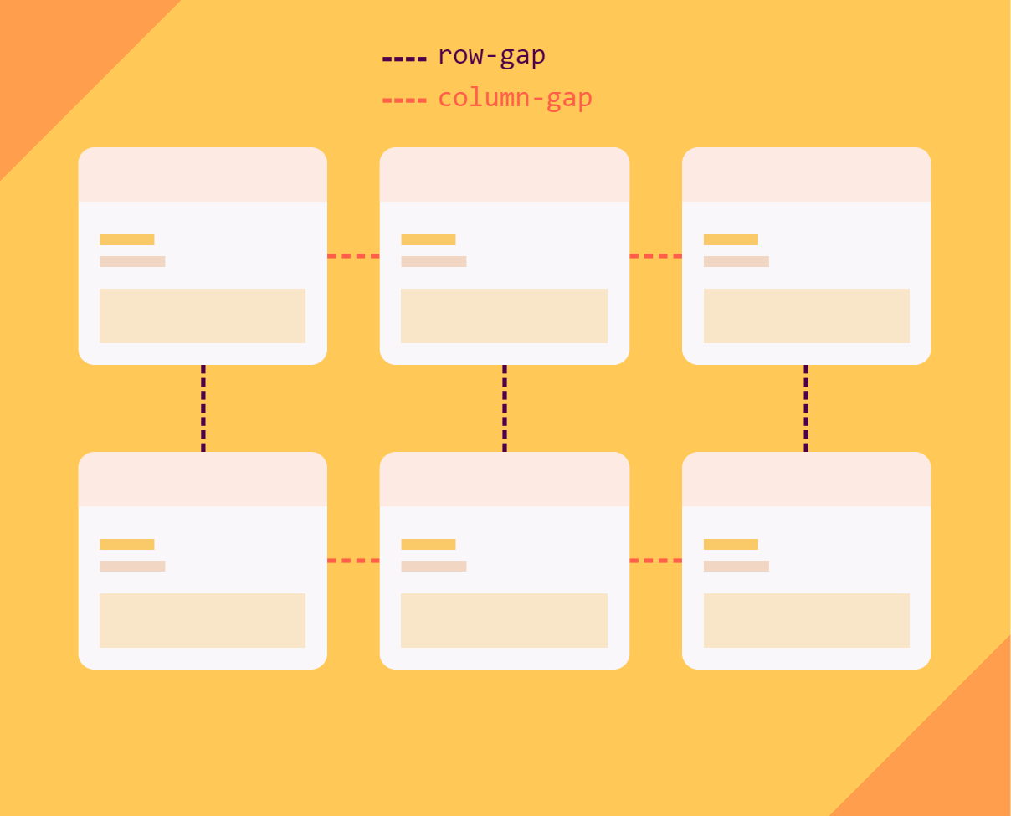
gap

Slide 133
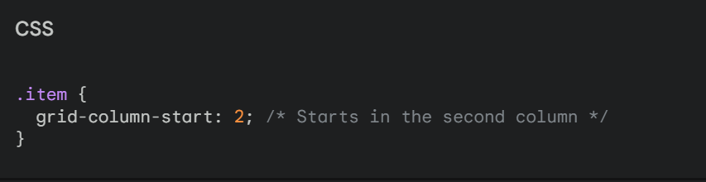
grid-column-start
Defines the starting column of an item.

Slide 134
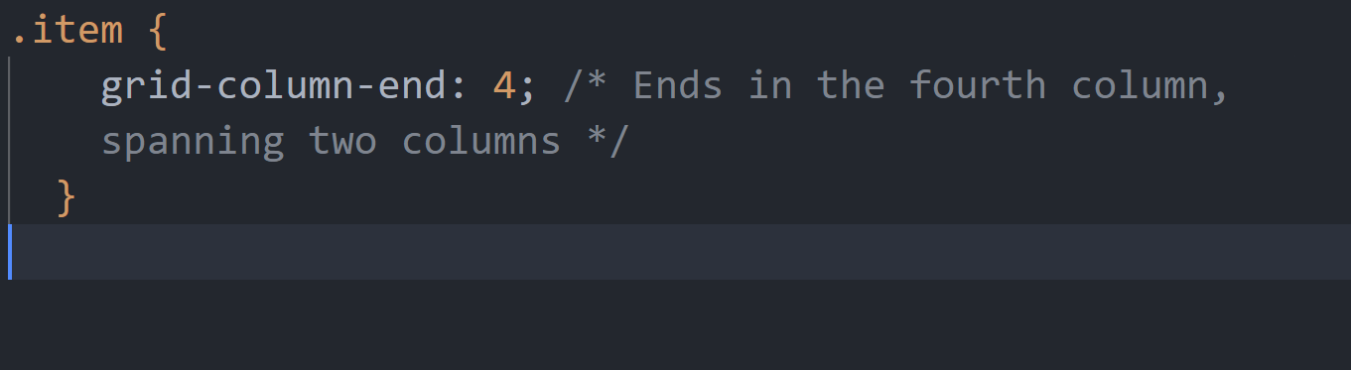
grid-column-end
Defines the ending column of an item.

Slide 135
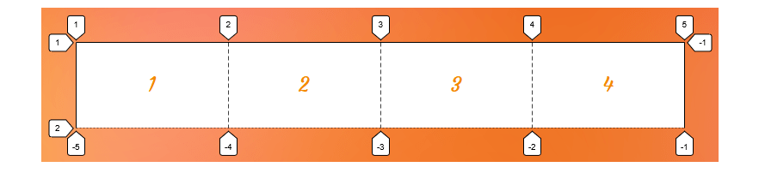
grid-column-start

Slide 136
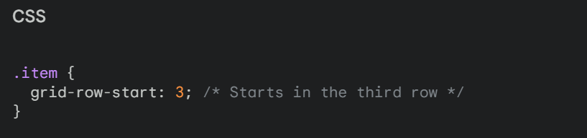
grid-row-start:
Defines the starting row of an item.

Slide 137
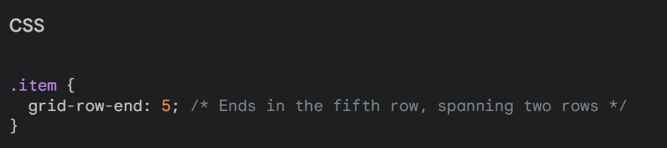
grid-row-end:
Defines the ending row of an item.

Slide 138
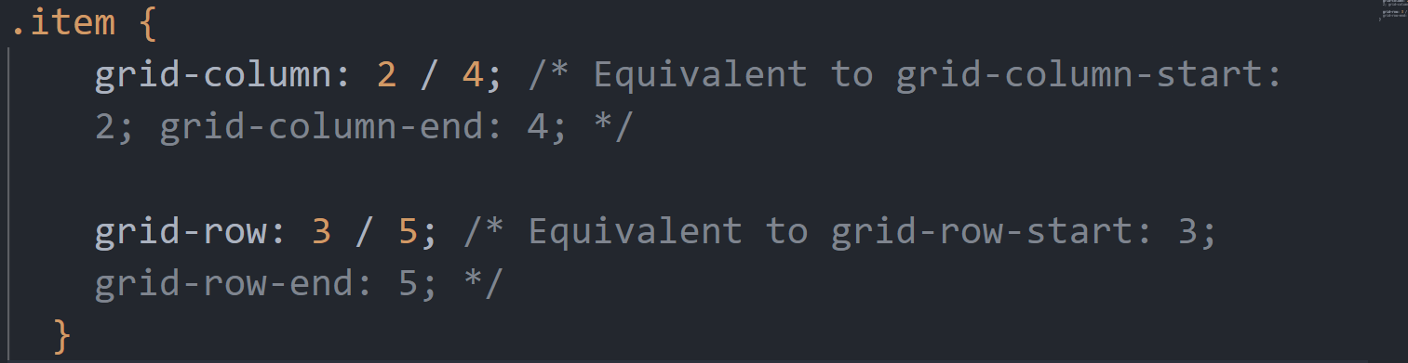
Note:
We can combine these properties to create complex grid layouts. For example:

Slide 139
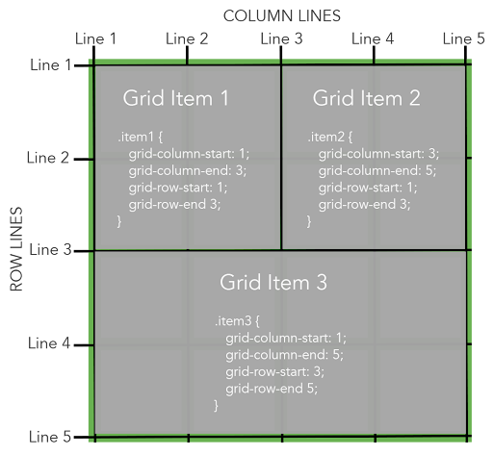

Slide 140
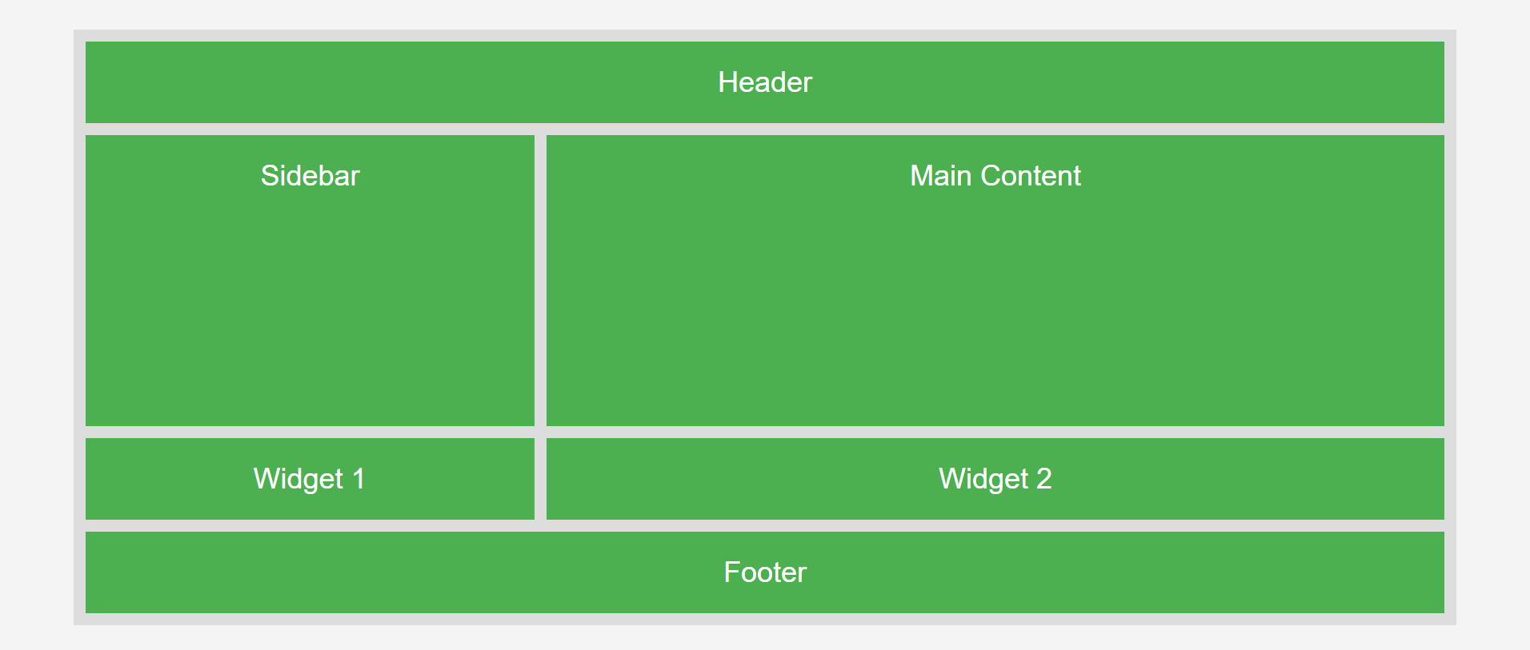
Create this layout

Slide 141
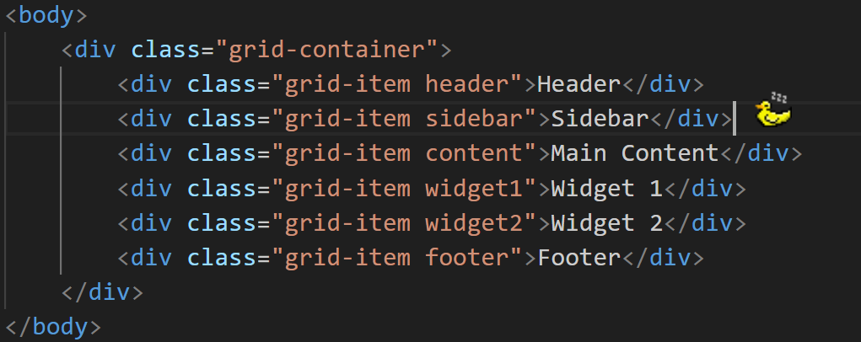
HTML

Slide 142
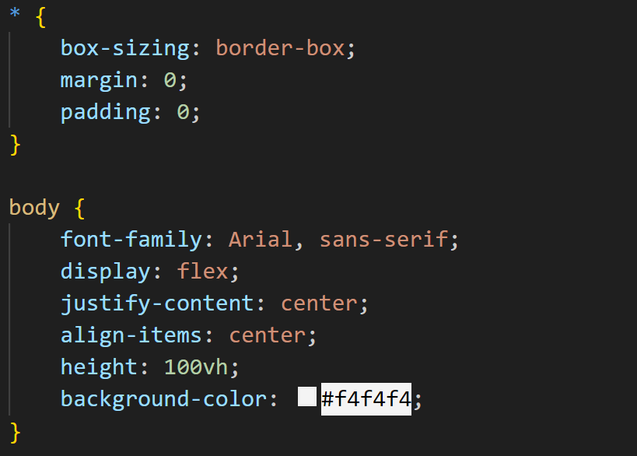
CSS

Slide 143

CSS

Slide 144

CSS

Slide 145

CSS

Slide 146
Students Kindly Create this Grid Layout

Slide 147


Slide 148
Learn Display Grid by Game
Visit: https://cssgridgarden.com/

Slide 149

Responsive Website using HTML and CSS

Slide 150

Understanding Media Query

Slide 151
What is Media Query?
Media Queries help you create responsive designs that adapt to different devices and screen sizes, ensuring your website looks great everywhere!

Slide 152

Different Screen Sizes

Slide 153

For Mobile Screen:

Slide 154

For Mobile Tablet:

Slide 155

For Laptop Tablet:

Slide 156

For Laptop Tablet:

Slide 157

Linking Different Screen CSS With HTML

Slide 158
Understanding Units
px: Pixels (Fixed size).
%: Percentage (Relative to parent).
vw, vh: Viewport width and height (% of viewport).
em, rem: Relative to font-size (em: element, rem: root element)

Slide 159

Understanding Units

Slide 160
CSS Animation

Slide 161


Slide 162

CSS animation properties:

Slide 163


Slide 164


Slide 165

Another example

Slide 166


Slide 167

Another example

Slide 168


Slide 169

Another example

Slide 170


Slide 171
Bouncing Ball Animation

Slide 172


Slide 173


Slide 174


Slide 175


Slide 176

Note:

Slide 177
JQuery

Slide 178


Slide 179


Slide 180



Slide 181


Slide 182



Slide 183


Slide 184



Slide 185


Slide 186
Different Types of Events

Slide 187


Slide 188


Slide 189
JQuery Effects

Slide 190


Slide 191


Slide 192


Slide 193

Note: Panel visibility should be hidden in CSS

Slide 194


Slide 195
JQuery Animate

Slide 196


Slide 197

Note: div position should be absolute in CSS

Slide 198
Small Utility Code

Slide 199


Slide 200


Slide 201


Slide 202


Slide 203


Slide 204
Start Learning & Contributing in Developer Communities

Slide 205






Dev.io
hashnode.com
medium.com
codepen.io
reddit.com
overapi.com
daily.dev

Slide 206


